Slide 1
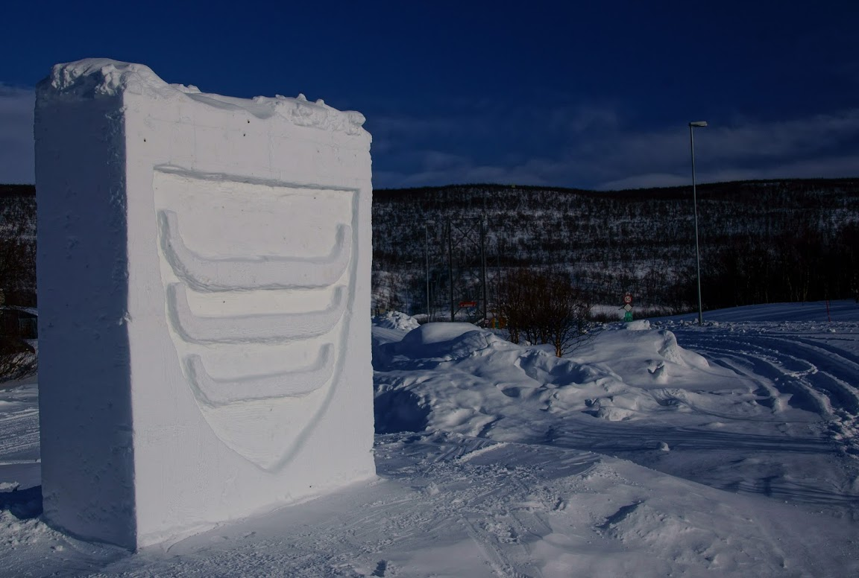
Welcome to
Deanu gielda – Tana Municipality
Presentation by Mayor of the municipality of Tana, Frank M. Ingilæ
Tana high school, Bonakas 25.03.2014

Slide 2
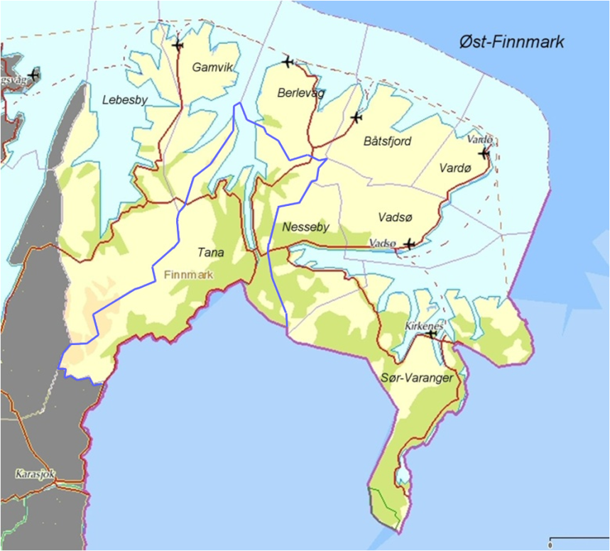
Municipality of Tana
General information
Multicultural - Norwegian, Sami and Finnish
Sami and Norwegian languages are official languages
about 2900 inhabitants
Total 4,049 km² area
Geographical and transport center
Border with Suomi-Finland
People from over 30 nations
Many small villages
Tana is Europe's best salmon river
Notes:
The area is 1.3 times larger than Oslo. Every citizen has 1.3 square kilometers.

Slide 3
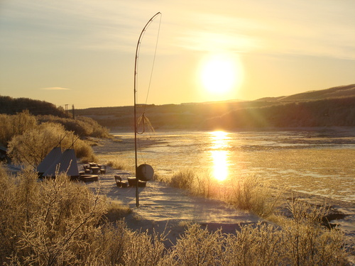
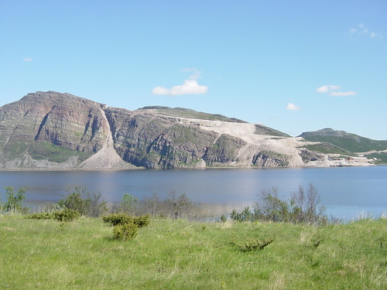
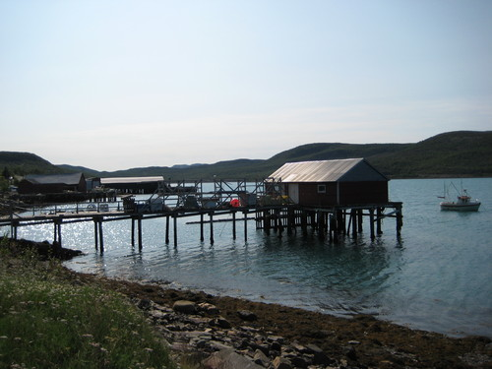
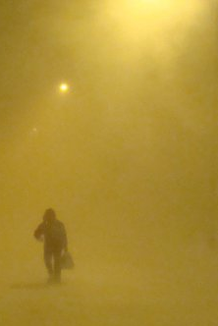
Municipality of Tana
General information continued
The river valley of the Tana is a green part of Finnmark with a good climate
Agriculture
Reindeer herding
Fjordfishing
Mining quartzite
Transport and logistics
building contractors
Few industrial jobs
Notes:
We are a bit different than many municipalities around us. We have a diverse private sectors based on primary industries. Agriculture is important about 200 jobs in total, Reindeer herding second most important and ultimately fisheries. In addition, many of the other jobs very dependent on the market in the municipalities around us.
Vi er litt annerledes enn mange kommuner rundt oss. Vi har et mangfoldig privat næringsliv med basis i alle primærnæringene. Landbruket er viktigs ca 200 arbeidsplasser totalt, Reindrifta og til sist fiskeri. I tillegg er mange av de andre næringene svært avhengig av marked i kommunene rundt oss.

Slide 4
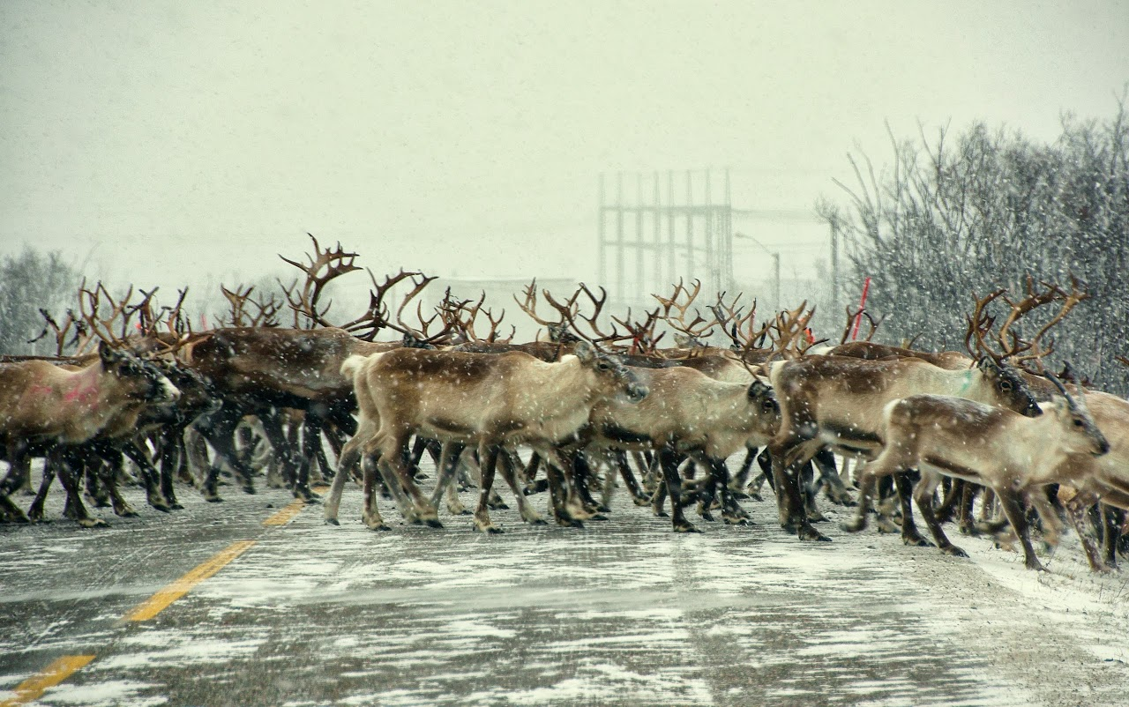
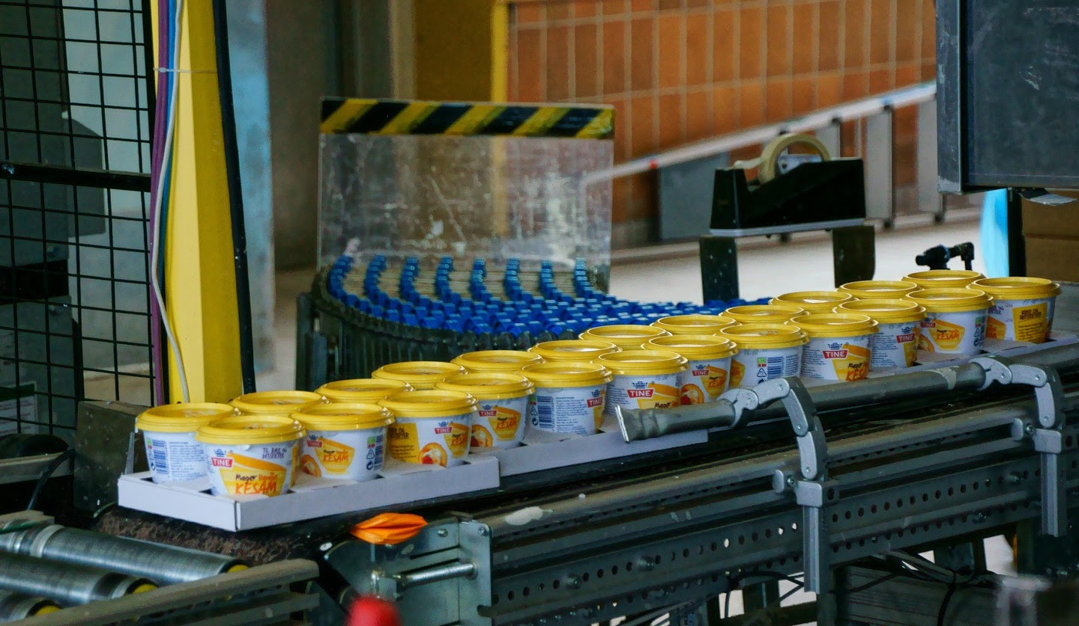
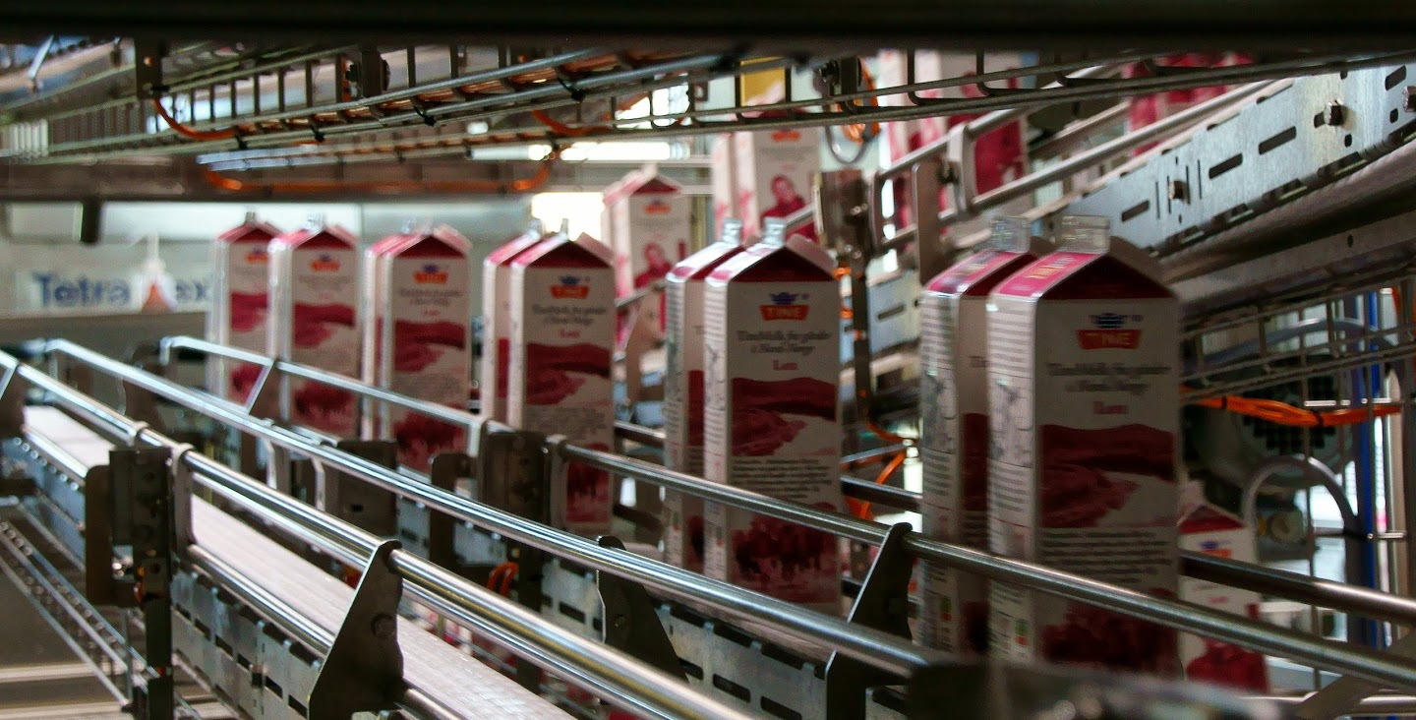
Food
We are a bit different than many municipalities around us. We have a diverse private sectors based on primary industries. Agriculture is most important about 200 jobs in total Reindeer herding second most important
Fisheries are growing.
In addition, many of the other jobs very dependent on the market and transportation to the municipalities around us.
Notes:
We are a bit different than many municipalities around us. We have a diverse private sectors based on primary industries. Agriculture is important about 200 jobs in total, Reindeer herding second most important and ultimately fisheries. In addition, many of the other jobs very dependent on the market in the municipalities around us.
Vi er litt annerledes enn mange kommuner rundt oss. Vi har et mangfoldig privat næringsliv med basis i alle primærnæringene. Landbruket er viktigs ca 200 arbeidsplasser totalt, Reindrifta og til sist fiskeri. I tillegg er mange av de andre næringene svært avhengig av marked i kommunene rundt oss.

Slide 5
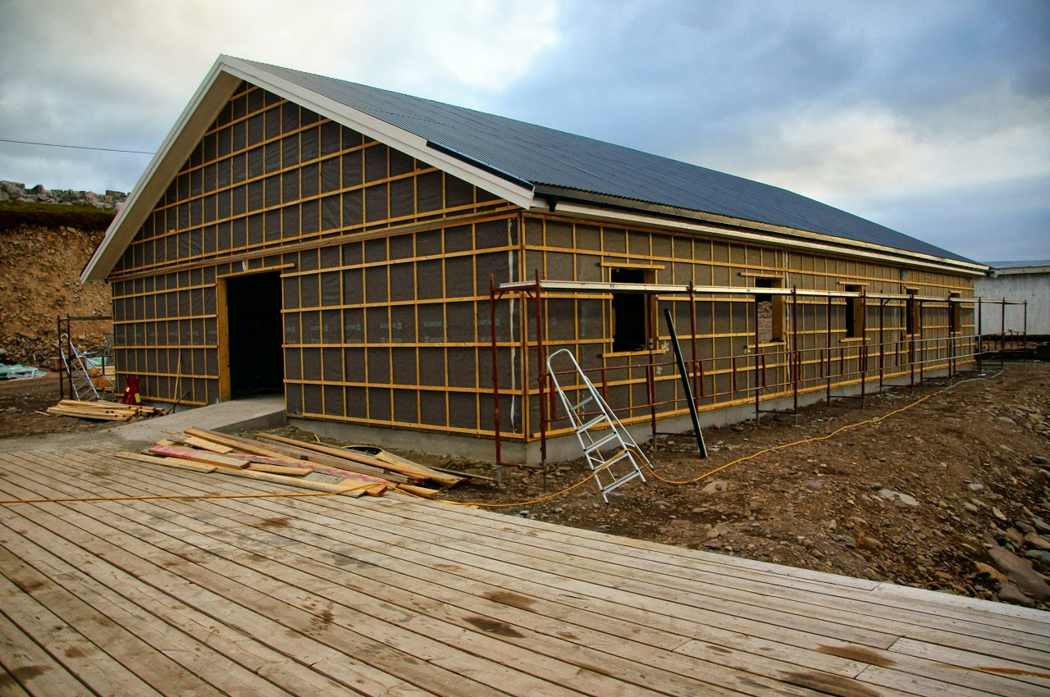
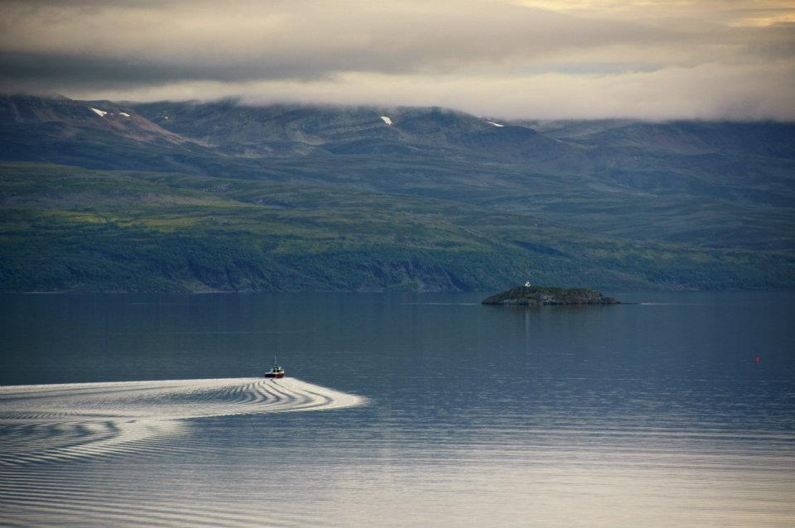
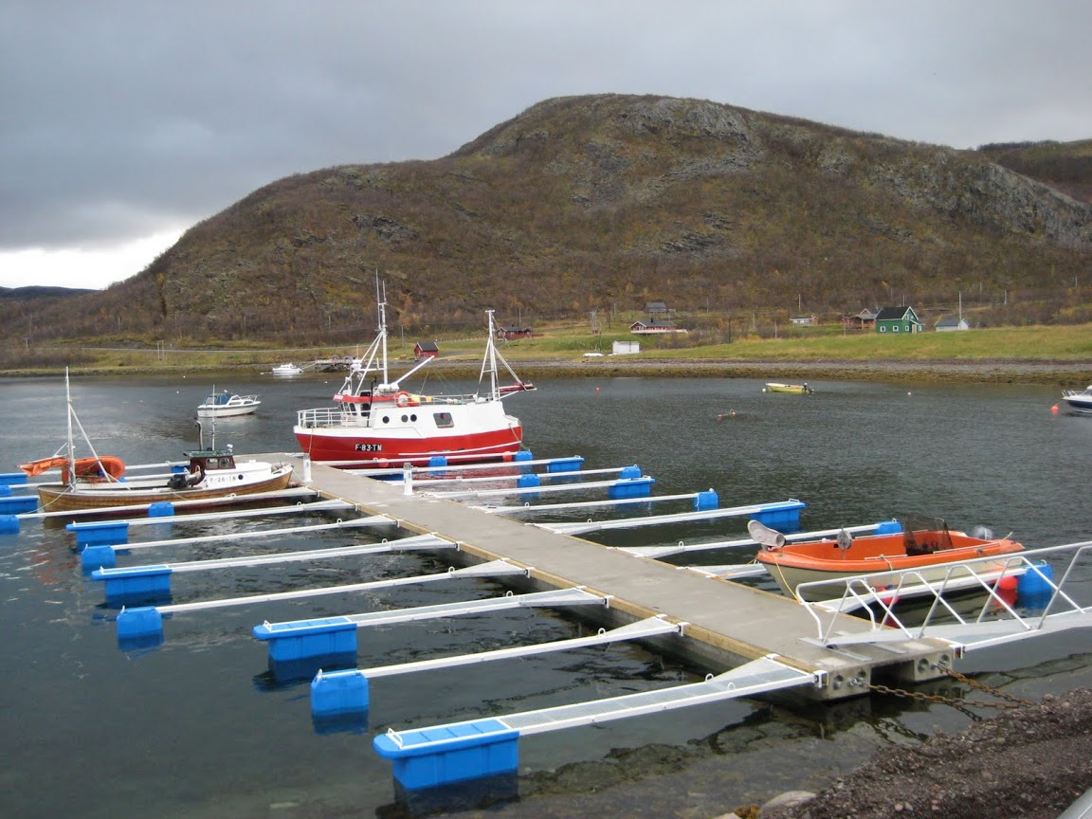
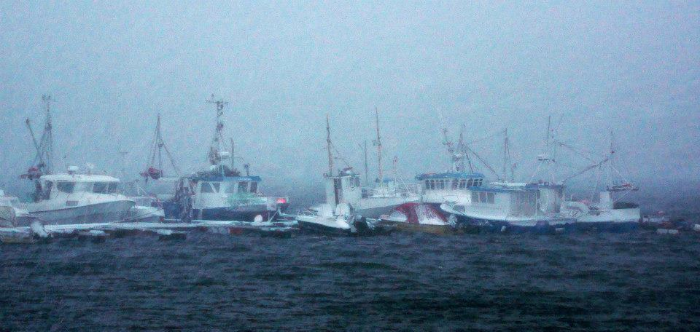
Fishery
Positive trend from 2007
More boats and fishermen
The municipality is building infrastructure
The municipality bought harbor
Built out floating docks
Constructs service building for fishermen

Slide 6
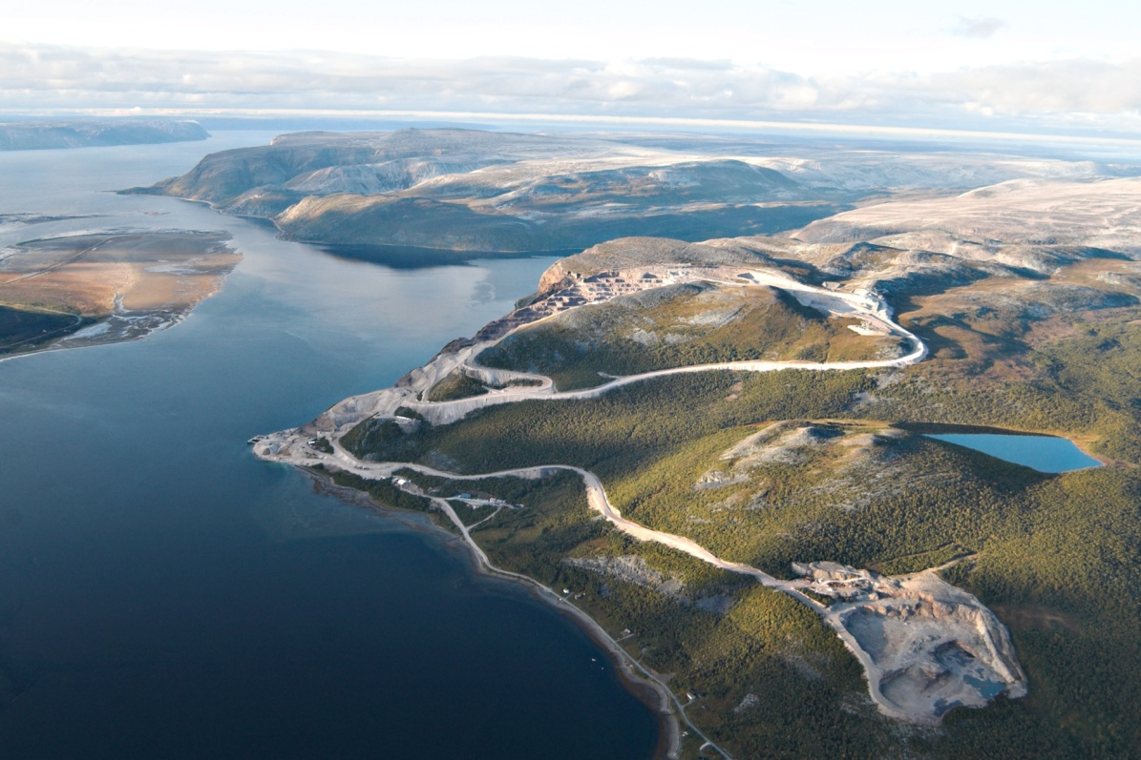
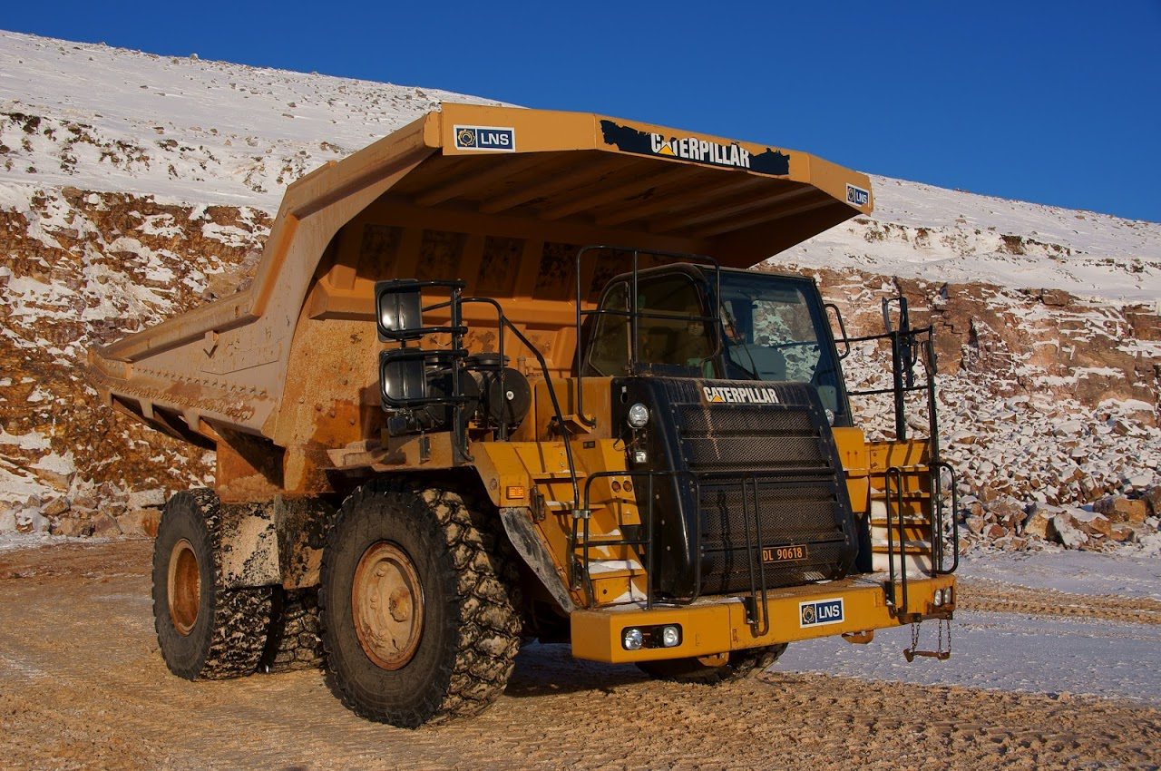
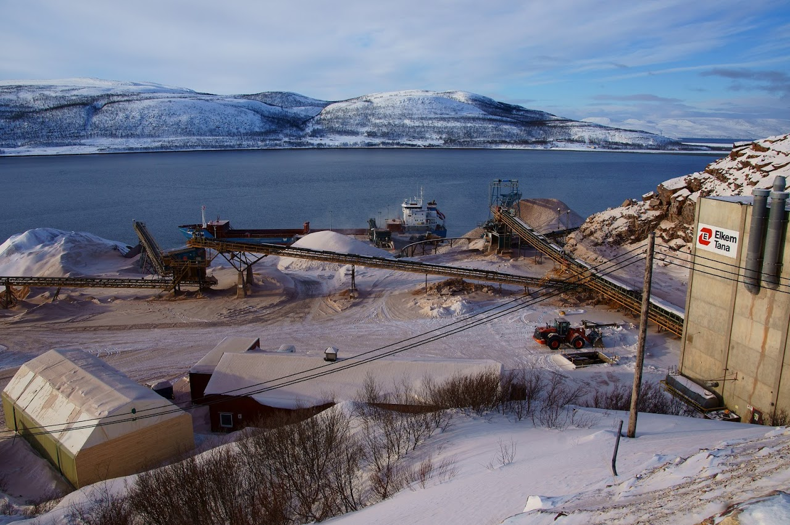
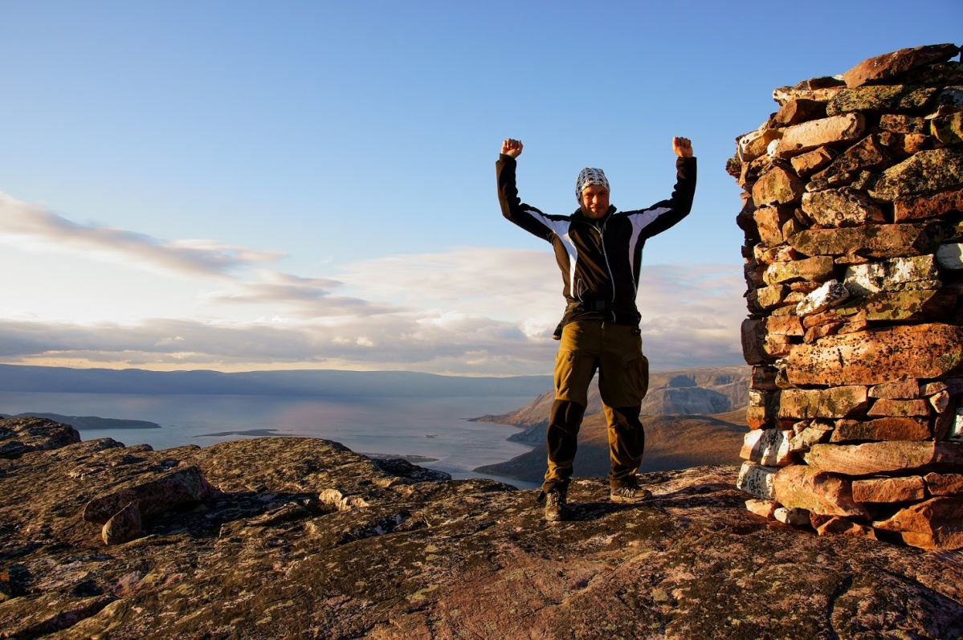
Mining in Tana
Elkem Tana AS
900,000 tonnes of quartzite shipped annually
41 jobs
Quartzite used in many products
Notes:
Arbeidsplassene er viktigst for kommunen på grunn av at det genererer inntekter gjennom inntektssystemet for kommunene
Bedriftsbeskatningen betyr lite for kommunen, men er selvfølgelig viktig for staten
Elkem Tana AS har hatt svært gode økonomiske resultater i mange år.
Ganske store kartlagte ressurser (flere 10 års drift).
Stort naturinngrep.
Lokal bekymring for hva som skjer når ressursen er tom.
Elkemkonsernet er nylig overtatt av Kinesiske interesser.

Slide 7
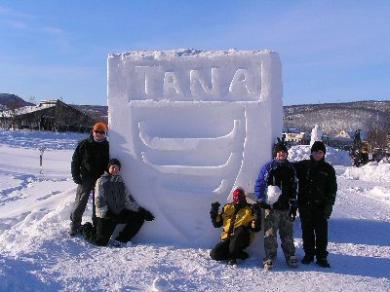
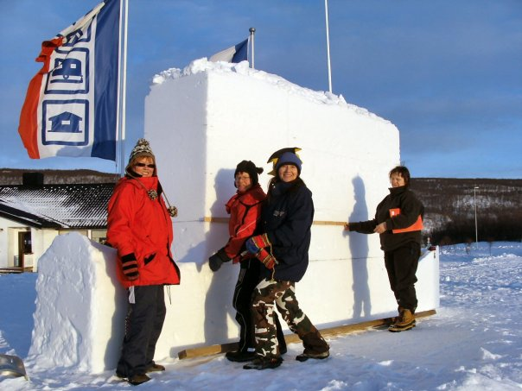
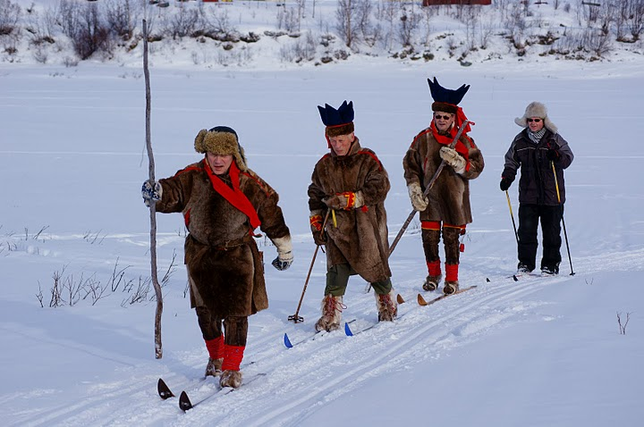
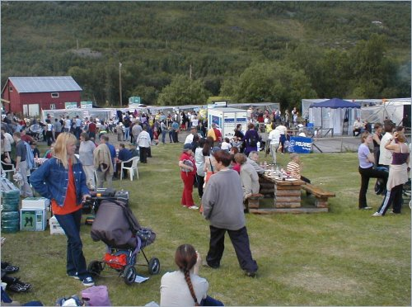
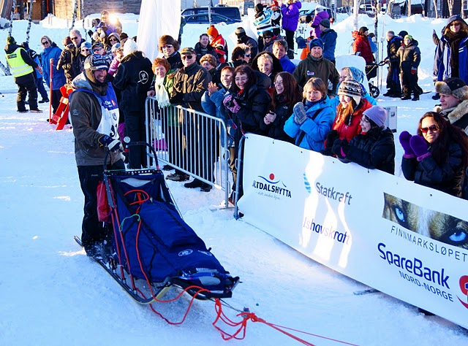
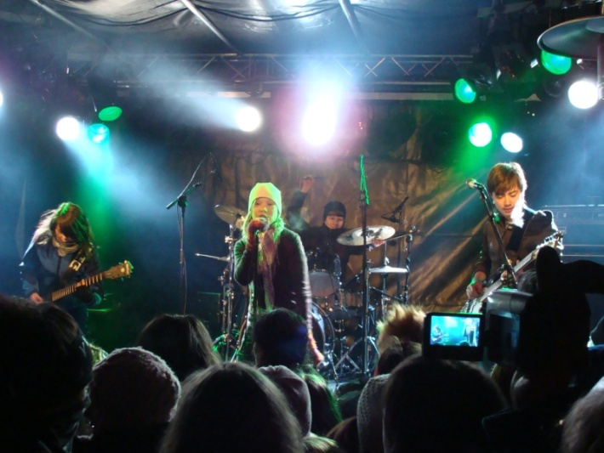
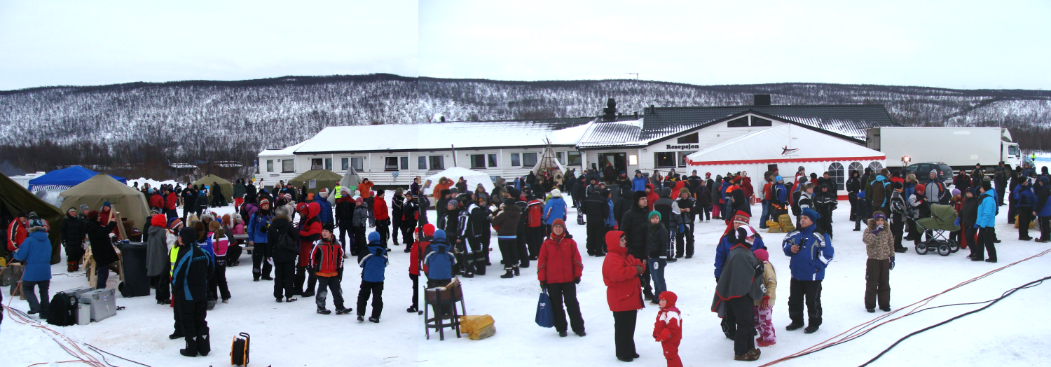
Voluntary sector in Tana
Winter market
Skiippagurra festival
Tana market
Notes:
Voluntary sector in Tana
Frivillige Tana

Slide 8
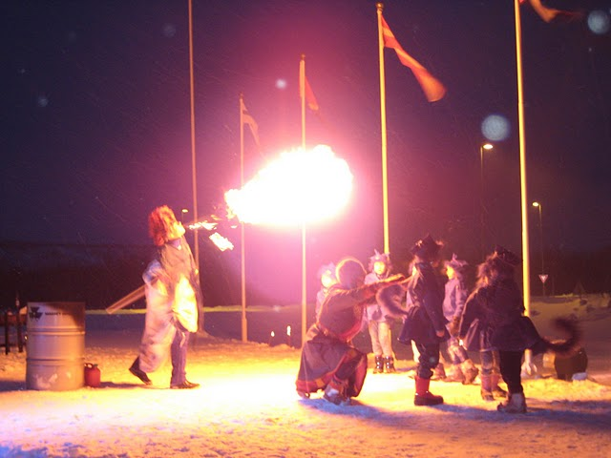
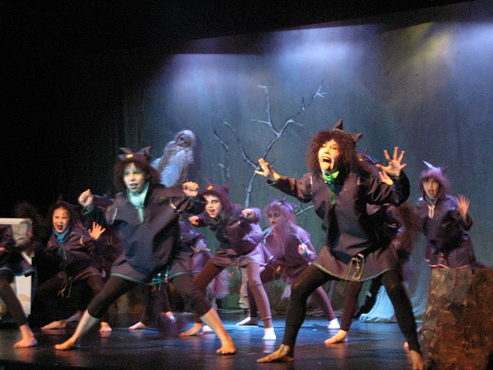
Sami children's theater
Notes:
In Tana has established Sami children's theater that has represented Norway in several international children's theater festivals. Children's theater is built around an arts school in Tana.

Slide 9
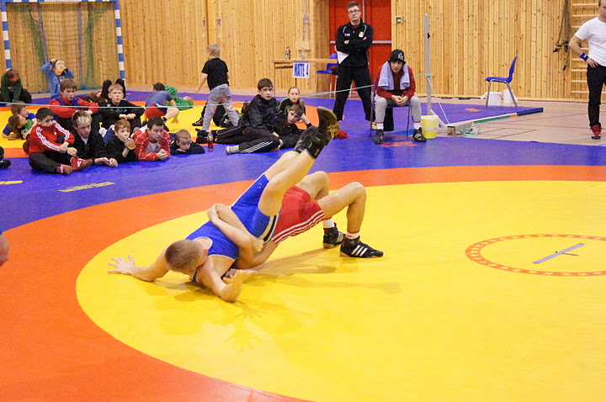
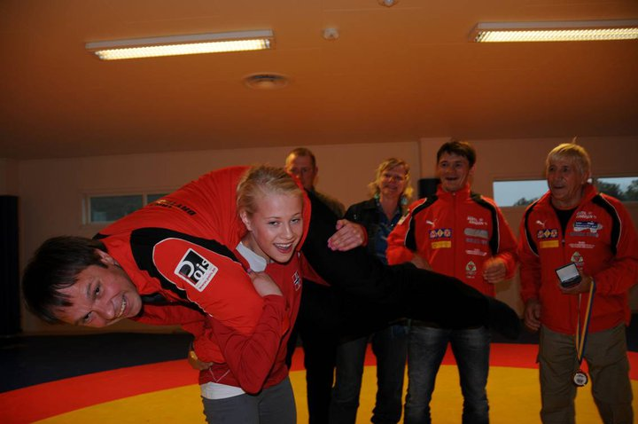
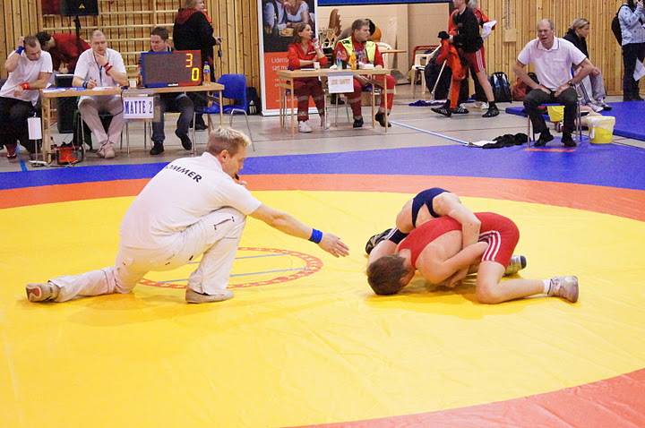
Wrestling
Notes:
In Tana, we have wrestling sport that we are very proud of. We have athletes who have participated and won the Norwegian championship. Has done well in European championship. In 2011 organized Tana wrestling club 3 big competitions. Norwegian championship and Tana Cup is the greatest
Tana Cup has participants from Norway, Sweden, Finland and Russia. There are athletes from Siberia and the Urals in Russia to participate in the competition.
Gold medal winner in the European Championships in wrestling Signe Marie Fidje Store from Tana is a strong young lady. Here she lifted the Mayor

Slide 10
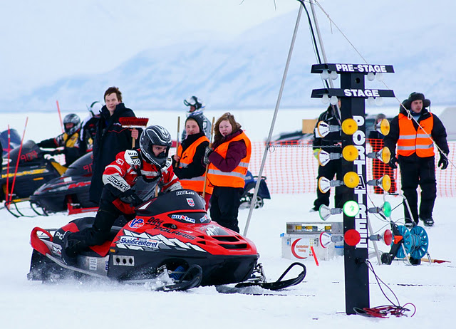
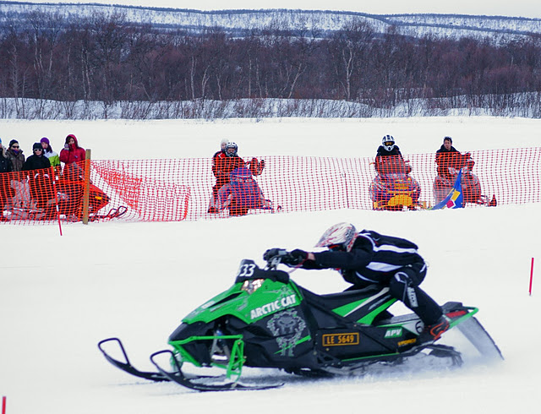
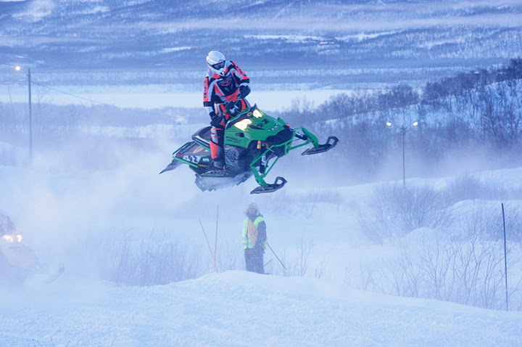
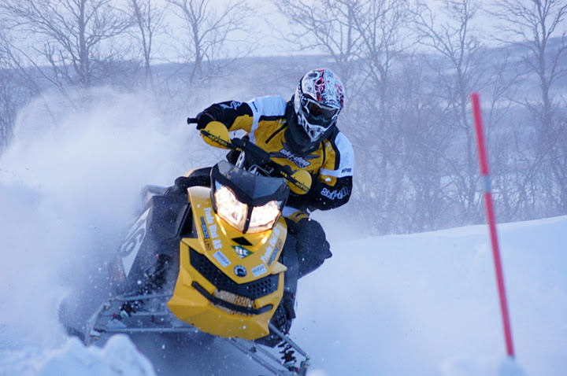
Snowmobile drag racing and cross
Notes:
Norwegian championships in snowmobile drag racing on the Tana River. Tana Motor Club was host

Slide 11
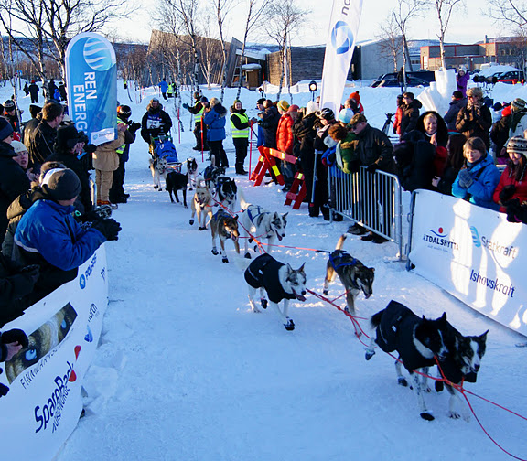
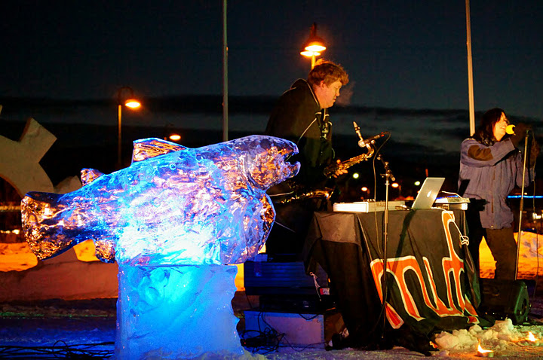
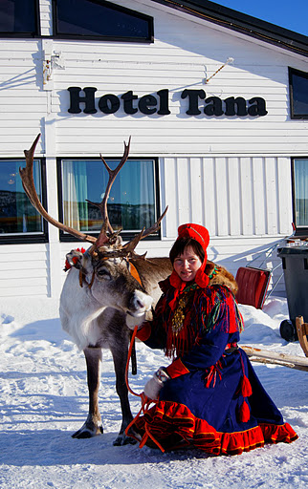
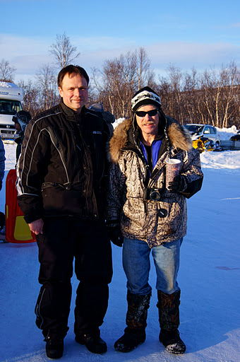
Finnmarksløpet
Notes:
Jeff King from Alaska and the winner of the Iditarod four times, guests Finnmarksløpet this year. I was fortunate enough to meet the King of the Iditarod when he was present during Finnmarksløpet this winter.

Slide 12
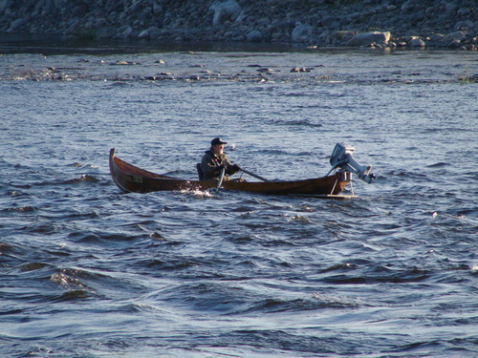
Local management of fish and fishing in the Tana river
The state has managed fisheries in Tana River
We have worked for many years to establish local management
In the spring of 2011
Provides new opportunities for businesses and local residents
Notes:
Tana River is considered to be the the lifeblood of the municipality (society) It was important for original settlement in the municipality. We have been working a long time politically for the local management of river. Decisions will then be moved closer to us and will provide new opportunities. Establishment of local government will certainly have a positive effect. The establishment of a local administrative authority - Tana River fish management - has taken over the responsibilities and tasks that have been managed by the State. (County Commissioner) Local administrative authority organize fishing, ensure adequate supervision of fish and manage the revenue from the sale of fishing licenses. Tana River fish management will also contribute to long-term conservation of fishery resources and participate in the cooperation with Finland on the management of the watercourse.

Slide 13
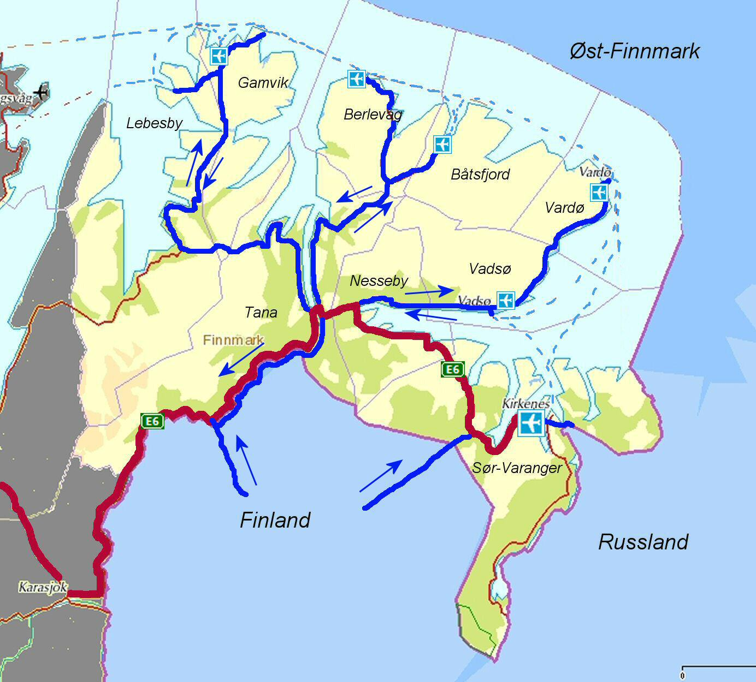
Transport corridors
Road
Exports of fish out of the county
Agriculture and husbandry
Goods and products via
Finland / Sweden
Internal transportation
Sea
Goods and people across the
Smalfjord kai
Growing exports from
Elkem's quarry in Austertana
Air
"In and out of the county" tourists year-round”

Slide 14
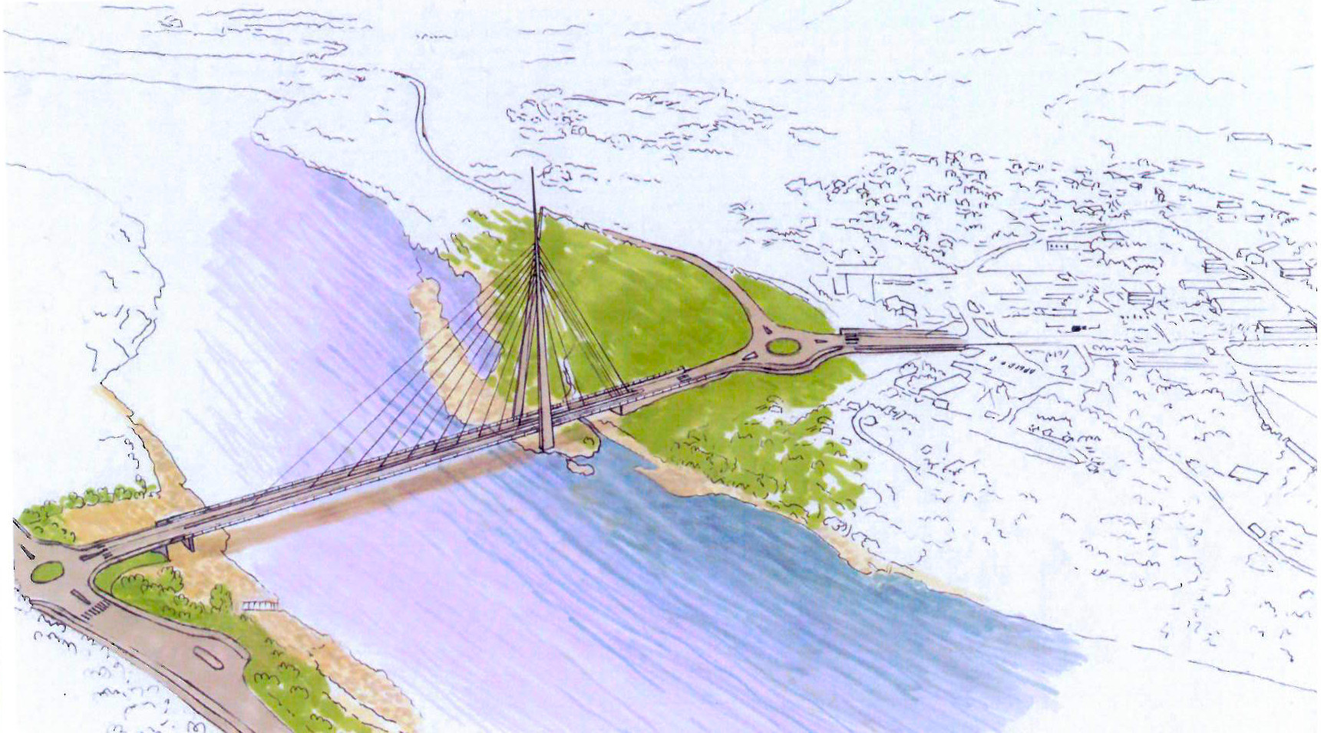
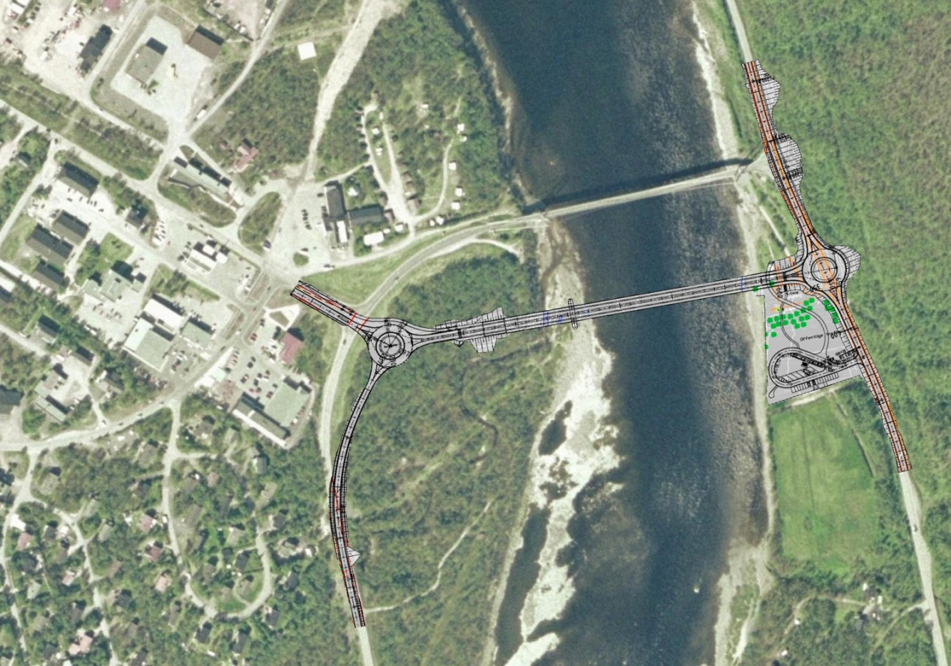
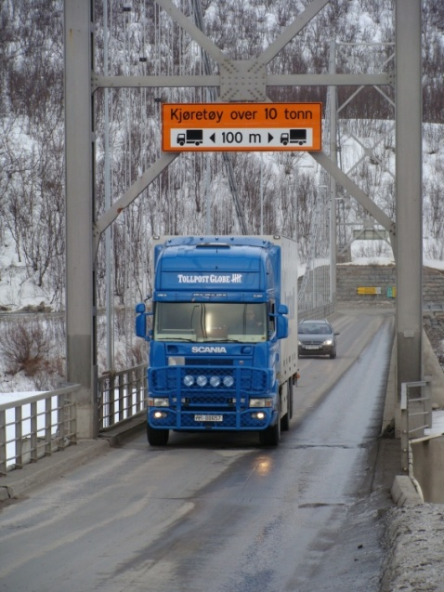
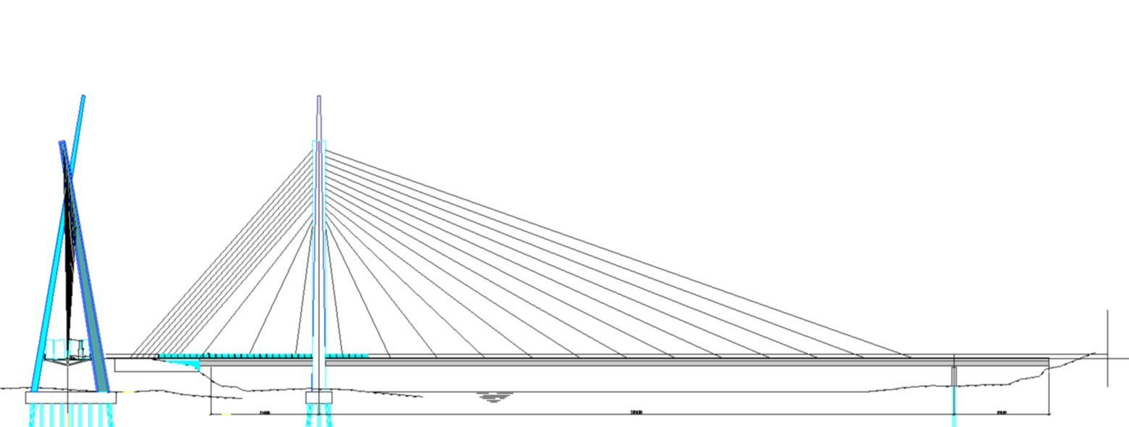
New Tana bridge in 2015 +?
Planning of new modern bridge
Built in 1948
Width, height and weight limitations
Main road (E6)
Gateway between East and West
Not suitable for today's vehicles
Pedestrians

Slide 15
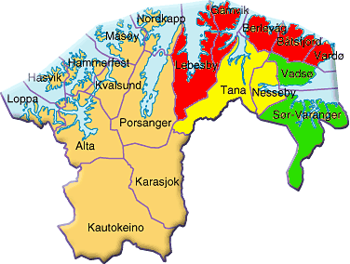
Educational level
Norut NIBR research in 2004 about education.
”Everybody (88%) have
to leave Tana to education
after primary school.”
♦10-14% with college or university education ♦15-17% with college or university education ♦21-24% with college or university education
Notes:
Rural municipalities have lower educational level than the regional centers. The distance to colleges and universities are often the answer to the level of education. The differences seem to increase over time, unfortunately.
There are huge differences in education between men and women due to the labor market. Women have higher education. Most women working in the public sector. Most men work in private firms. Private firms require less education than the public sector.

Slide 16
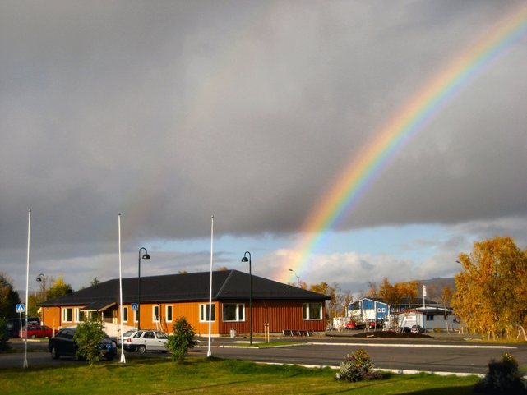
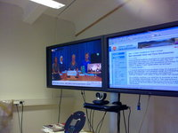
Our solution:
” In the end of the rainbow is…education” We are committed to flexible education at all levels.
Our ”house of knowledge” was ready in November 09
College education with videoconferencing
Education for adults
LOSA (local ed. in cooperation with employment)
Training for unemployed
Notes:
Tana municipality takes responsibility for education beyond primary school. We are committed to flexible education at all levels. East Finnmark competence center was recently established in Tana
We want to equalize educational differences. We focus on education. Most had to travel from Tana to education after primary school. Our response is more and more local education. It will contribute to greater local competitiveness

Slide 17
Human resources
The municipality's main resource is the people who live in our community. We want to help those who want an opportunity to lifelong learning either through education or through their own experiences. To make use of the human resources that exist in the community is demanding, but necessary if we are to achieve a positive development in the future.

Slide 18
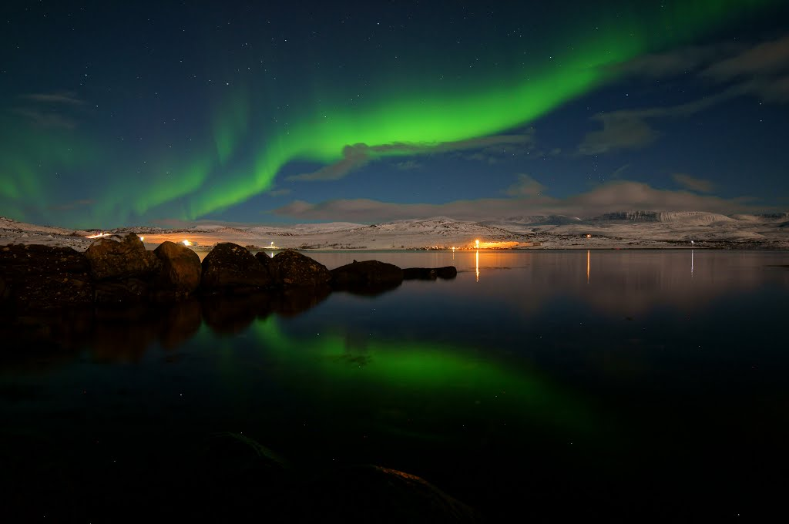
Thank you for your attention
Aurora borealis in Tana
Notes:
The end!

